Slide 1

Foundation PHYSICS
Seminar 5: ELECTRIC FORCE & COULOMB’S LAW

Slide 2
Learning outcomes
Students will be able to apply critical thinking and analytical skills to solve problems regarding:
Static Electricity
Electric Charge
Electric Force: Coulomb’s Law
Electric Field
Applications of Electrostatics

Slide 3
Practice Question 1
Why do electric field lines point away from positive charges and toward negative charges?
When you walk across a nylon rug and then touch a large metal object, you may get a spark and a shock. What causes this to happen?

Slide 4
ANSWER: Practice Question 1
1. Definition of an Electric Field
An electric field (E) is a vector field that represents the force per unit charge experienced by a positive test charge placed in the field.
The direction of the electric field at any point is the direction of the force that would be experienced by a positive test charge placed at that point.
Why This Happens
Coulomb’s law states that like charges repel each other, and opposite charges attract each other.
This fundamental law of electrostatics is the reason why electric field lines behave the way they do.

Slide 5
ANSWER: Practice Question 1
Why This Happens
For a positive charge, the electric field vectors point outward because any positive test charge would be repelled.
For a negative charge, the electric field vectors point inward because any positive test charge would be attracted.
Electric field lines point away from positive charges and toward negative charges because they represent the direction of the force that a positive test charge would experience in the presence of these charges.

Slide 6
ANSWER: Practice Question 2
2. Friction and Charge Transfer:
As you walk across the nylon rug, friction between your shoes and the rug causes electrons to be transferred from one material to the other.
Nylon, a synthetic material, tends to lose electrons and become positively charged (when rubbed against rubber) and hence the shoes/body may gain these electrons and become negatively charged.
Electric Potential Difference:
The accumulation of charge creates a difference in electric potential (voltage) between your body and other objects in your environment.
The larger the charge imbalance, the greater the potential difference.

Slide 7
ANSWER: Practice Question 2
Discharge and Spark:
When you touch a large metal object, such as a doorknob, the stored static charge on your body suddenly discharges.
Metal is a good conductor of electricity, so the electrons quickly move from your body to the metal object, or vice versa, depending on the charge polarity.
This rapid movement of electrons (discharge) through the air creates a spark, which is a visible flash of light.
The spark occurs because the air, normally an insulator, becomes ionized (charged particles are created), allowing current to flow.

Slide 8
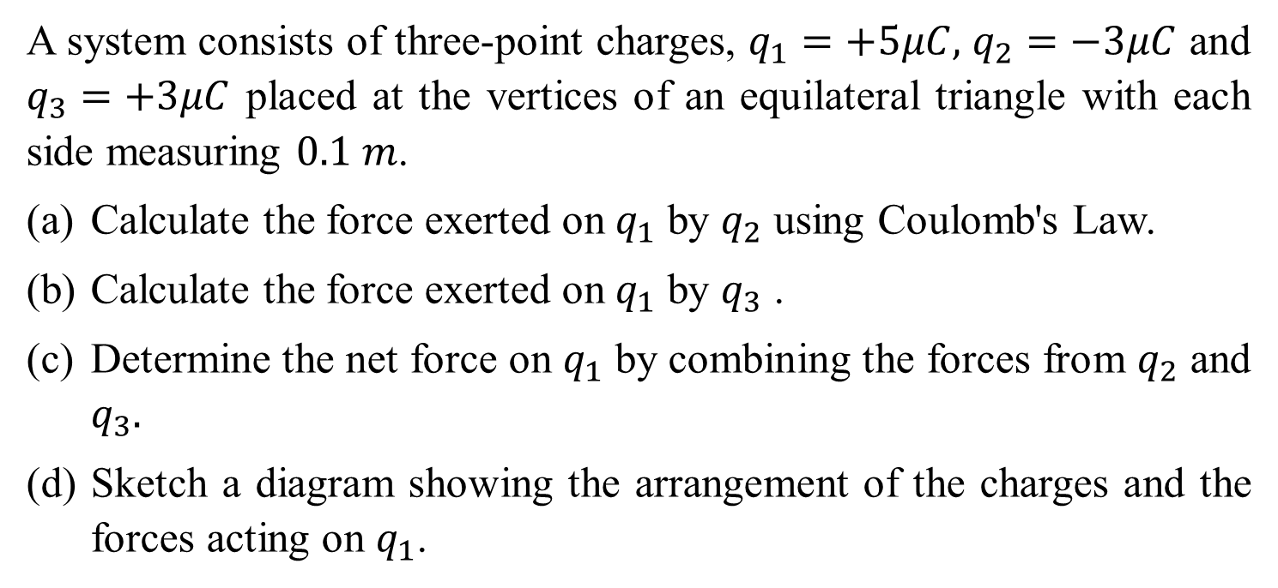
Question 1
A system consists of three-point charges, $q_{1}=+5μC,$ $q_{2}=−3μC$ and $q_{3}=+3μC$ placed at the vertices of an equilateral triangle with each side measuring $0.1 m$.
Calculate the force exerted on $q_{1}$ by $q_{2}$ using Coulomb's Law.
Calculate the force exerted on $q_{1}$ by $q_{3}$ ​.
Determine the net force on $q_{1}$​ by combining the forces from $q_{2}$ and $q_{3}.$
Sketch a diagram showing the arrangement of the charges and the forces acting on $q_{1}$​.

Slide 9
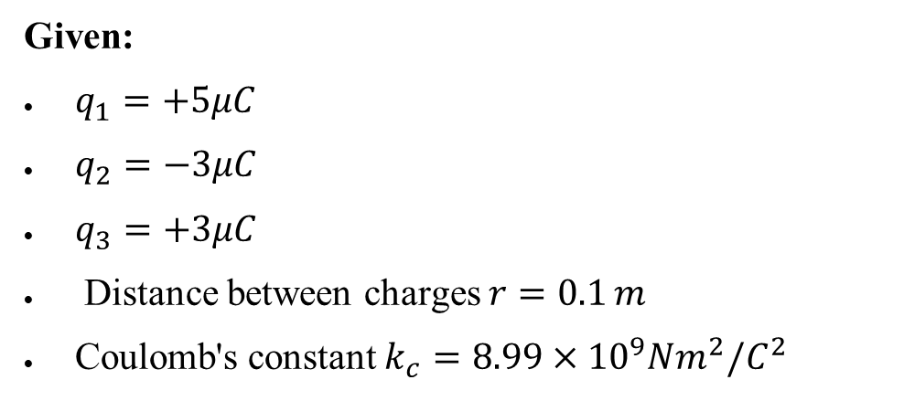

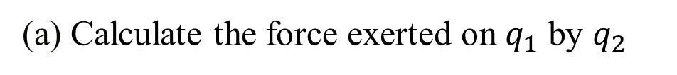
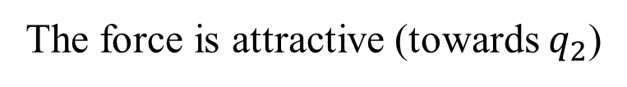

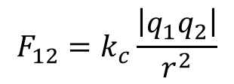
Question 1: ANSWER
Given:
$q_{1}=+5μC$
$q_{2}=−3μC$
$q_{3}=+3μC$
Distance between charges $r=0.1 m$
Coulomb's constant $k_{c}=8.99×{10}^{9}Nm^{2}/C^{2}$
(a) Calculate the force exerted on $q_{1}$ by $q_{2}$
Using Coulomb's Law
$$F_{12}=k_{c}\frac{\left|q_{1}q_{2}\right|}{r^{2}}$$
$$F_{12}=8.99×{10}^{9}\frac{\left|\left(5×{10}^{−6}\right)∙\left(−3×{10}^{−6}\right)\right|}{{\left(0.1\right)}^{2}}$$
$$F_{12}=13.5 N$$
The force is attractive (towards $q_{2}$​)

Slide 10
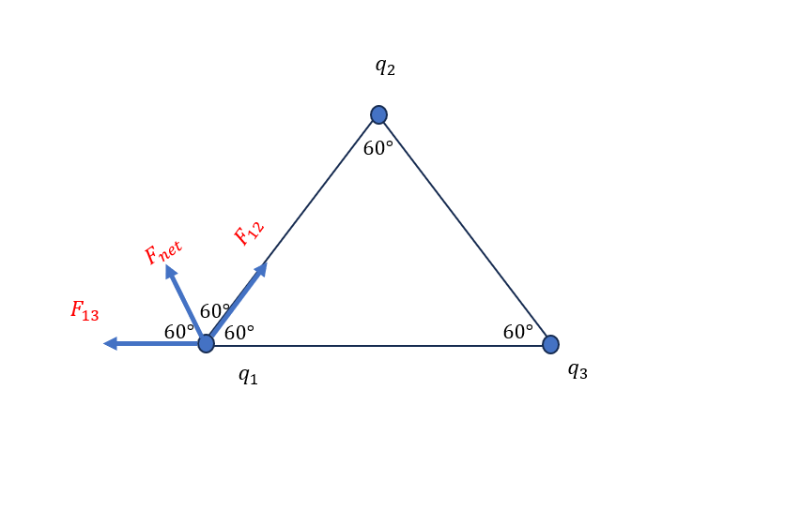
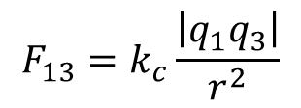
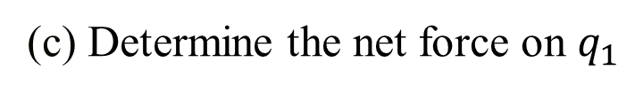
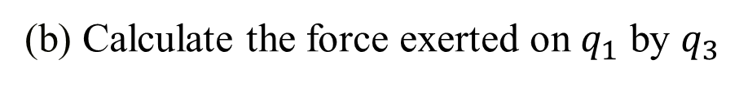
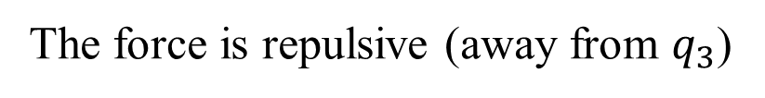


Question 1: ANSWER
(b) Calculate the force exerted on $q_{1}$ by $q_{3}$
$$F_{13}=k_{c}\frac{\left|q_{1}q_{3}\right|}{r^{2}}$$
$$F_{13}=8.99×{10}^{9}\frac{\left|\left(5×{10}^{−6}\right)∙\left(3×{10}^{−6}\right)\right|}{{\left(0.1\right)}^{2}}$$
$$F_{13}=13.5N$$
The force is repulsive (away from $q_{3}$​)
(c) Determine the net force on $q_{1}$

Slide 11
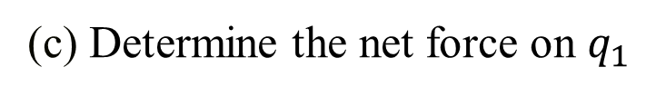

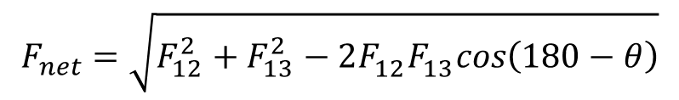
Question 1: ANSWER
(c) Determine the net force on $q_{1}$
Since the forces are vectors and we are in an equilateral triangle, we need to use vector addition to calculate the net force.
Using the formula for the resultant of two forces at an angle:
$$F_{net}^{2}=F_{12}^{2}+F_{13}^{2}−2F_{12}^{}F_{13}^{}cos\left(180−θ\right)$$
$$F_{net}=\sqrt{F_{12}^{2}+F_{13}^{2}−2F_{12}^{}F_{13}^{}cos\left(180−θ\right)}$$
$$F_{net}=\sqrt{{\left(13.5\right)}^{2}+{\left(13.5\right)}^{2}−2\left(13.5\right)\left(13.5\right)cos\left(60°\right)}$$
$$F_{net}=13.5N$$

Slide 12
Question 1: ANSWER
(d) Diagram showing the arrangement of the charges and the forces
The direction of the force will be such that it bisects the 120 degree angle given that the two induced forces happen to be equal.

Slide 13
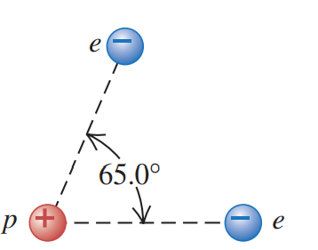
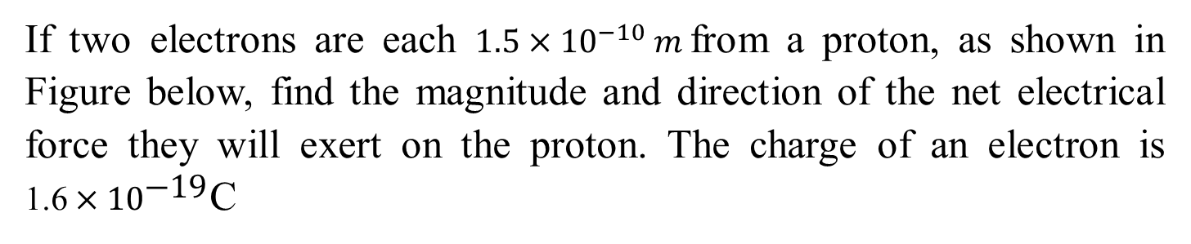
Question 2
If two electrons are each $1.5×{10}^{−10} m$from a proton, as shown in Figure below, find the magnitude and direction of the net electrical force they will exert on the proton. The charge of an electron is ${\text{1.6}×10}^{\text{−19}}$C

Slide 14
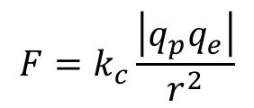
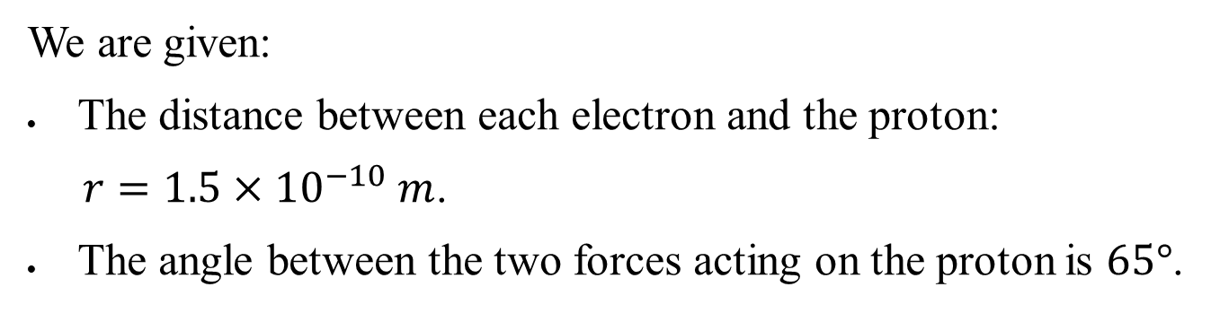
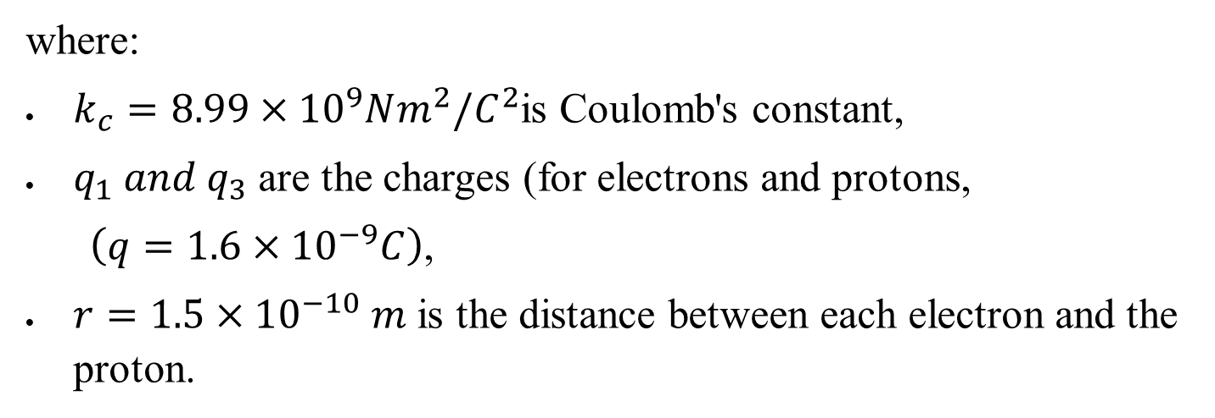
Question 2: ANSWER
We are given:
The distance between each electron and the proton:
$r=1.5×{10}^{−10} m$.
The angle between the two forces acting on the proton is $65°$.
Calculate the Force between Each Electron and the Proton
Using Coulomb's law
$$F=k_{c}\frac{\left|q_{p}q_{e}\right|}{r^{2}}$$
where:
$k_{c}=8.99×{10}^{9}Nm^{2}/C^{2}$is Coulomb's constant,
$q_{1} and q_{3}$ are the charges (for electrons and protons,
$\left(q=1.6×{10}^{−9}C\right)$,
$r=1.5×{10}^{−10} m$ is the distance between each electron and the proton.

Slide 15
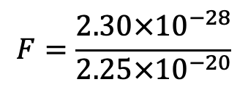
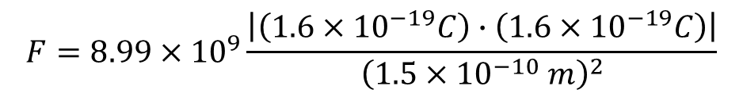
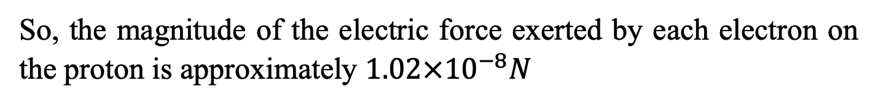

Question 2: ANSWER
Since the force is the same for both electrons:
$$F=8.99×{10}^{9}\frac{\left|\left(1.6×{10}^{−19}C\right)∙\left(1.6×{10}^{−19}C\right)\right|}{{\left(1.5×{10}^{−10} m\right)}^{2}}$$
$$F=\frac{2.30×{10}^{−28}}{2.25×{10}^{−20}}$$
$$F=1.02×{10}^{−8}N$$
So, the magnitude of the electric force exerted by each electron on the proton is approximately $1.02×{10}^{−8}N$

Slide 16
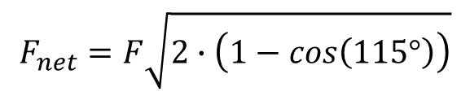
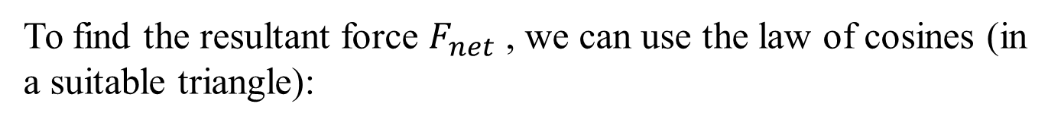

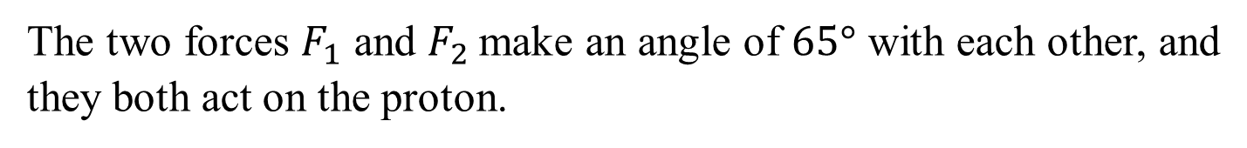


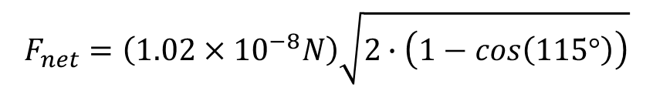
Question 2: ANSWER
Calculate the Net Force Using the Cosine Rule:
The two forces $F_{1}$ and $F_{2}$make an angle of $65°$ with each other, and they both act on the proton.
To find the resultant force $F_{net}$ ​, we can use the law of cosines (in a suitable triangle):
$$F_{net}^{2}=F_{1}^{2}+F_{2}^{2}−2F_{1}∙F_{2}∙cos\left(180−θ\right)$$
Given $F_{1}=$ $F_{2}=F and θ=65°$
$$F_{net}^{2}=2F^{2}∙\left(1−cos\left(115°\right)\right)$$
$$F_{net}^{2}=F^{2}+F^{2}−2F∙F∙cos\left(115°\right)$$
$$F_{net}=F\sqrt{2∙\left(1−cos\left(115°\right)\right)}$$
$$F_{net}=\left(1.02×{10}^{−8}N\right)\sqrt{2∙\left(1−cos\left(115°\right)\right)}$$
$$\text{Magnitude} \text{of} \text{the} \text{net} \text{force} { F}_{net}=1.72×{10}^{−8}N$$
Direction: The net force will be directed along the bisector of the $65°$angle between the forces exerted by the two electrons on the proton.

Slide 17
Question 3
A plastic rod is rubbed with wool, making the rod negatively charged by 6.0 µC. The rod is then brought close to a neutral metal sphere on an insulating stand.
Describe the process of charging the rod by friction.
Explain the process of inducing charge on the metal sphere when the rod is brought close.
If the sphere is grounded while the rod is nearby, describe what happens to the sphere. Subsequently we remove the grounding and then the rod. What is the charge of the sphere now?

Slide 18
Question 3: ANSWER
(a) Describe the process of charging the rod by friction
When the plastic rod is rubbed with wool, electrons are transferred from the wool to the rod, making the rod negatively charged.
(b) The process of inducing charge on the metal sphere
When the negatively charged rod is brought near the neutral metal sphere, electrons in the sphere are repelled, creating a positive charge near the rod and a negative charge on the far side due to electrostatic induction.
This redistribution of charge is temporary and doesn’t change the total charge of the sphere; it simply rearranges it.
(c) If the sphere is grounded while the rod is nearby
If the sphere is then grounded while the rod is still nearby, electrons will be repelled from the sphere into the ground because they’re being repelled by the rod’s negative charge. If the grounding connection is removed, the sphere will retain a net positive charge (since some of its electrons have flowed away to the ground). Finally, if the rod is removed, the remaining positive charges will redistribute uniformly on the sphere, leaving it positively charged.

Slide 19
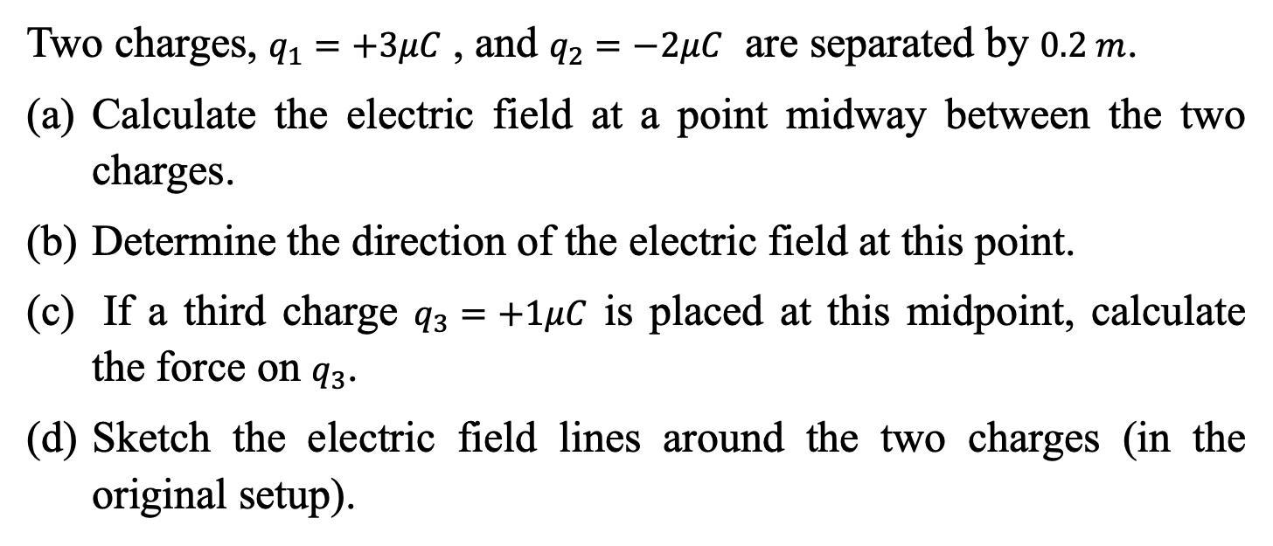
Question 4
Two charges, $q_{1}=+3μC$ , and $q_{2}=−2μC$ are separated by $0.2 m$.
Calculate the electric field at a point midway between the two charges.
Determine the direction of the electric field at this point.
If a third charge $q_{3}=+1μC$ is placed at this midpoint, calculate the force on $q_{3}$.
Sketch the electric field lines around the two charges (in the original setup).

Slide 20
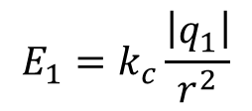
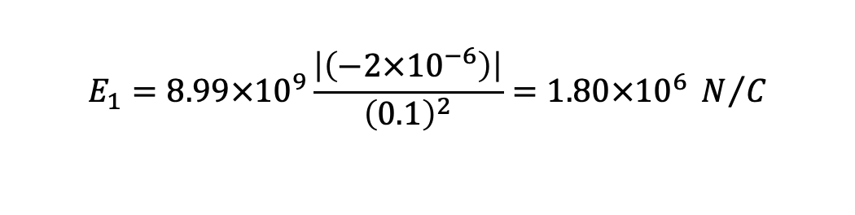
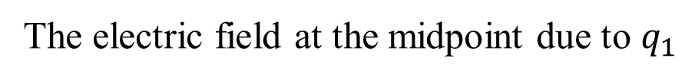
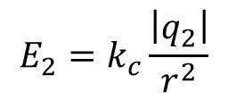
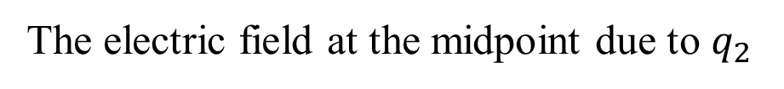
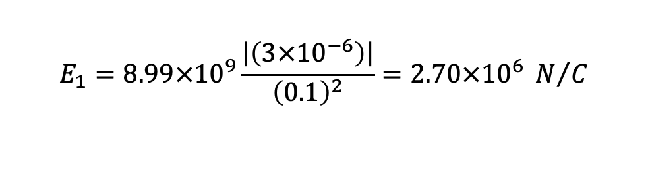
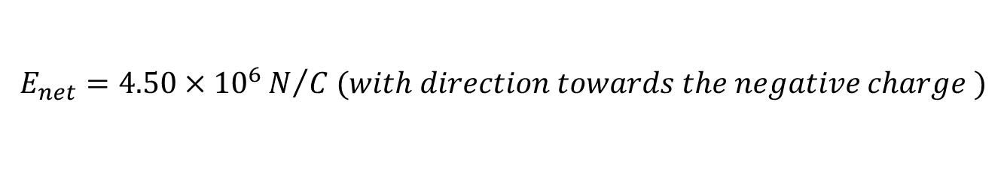
Question 4: ANSWER
(a) Electric field at a point midway between the two charges
The electric field at the midpoint due to $q_{1}$
$$E_{1}=k_{c}\frac{\left|q_{1}\right|}{r^{2}}$$
$$E_{1}=8.99×{10}^{9}\frac{\left|\left(3×{10}^{−6}\right)\right|}{{\left(0.1\right)}^{2}}=2.70×{10}^{6} N/C$$
The electric field at the midpoint due to $q_{2}$
$$E_{1}=8.99×{10}^{9}\frac{\left|\left(−2×{10}^{−6}\right)\right|}{{\left(0.1\right)}^{2}}=1.80×{10}^{6} N/C$$
$$E_{2}=k_{c}\frac{\left|q_{2}\right|}{r^{2}}$$
The electric field due to the negative charge will point toward the negative charge, and the electric field due to the positive charge will point away from the positive charge. Thus, both fields point in the same direction, towards the negative charge, and so can be added
The net electric field is:
$$E_{net}=E_{1}+E_{2}=2.70×{10}^{6}+1.80×{10}^{6}$$
$$E_{net}=4.50×{10}^{6}N/{C (with direction towards the negative charge )}$$

Slide 21
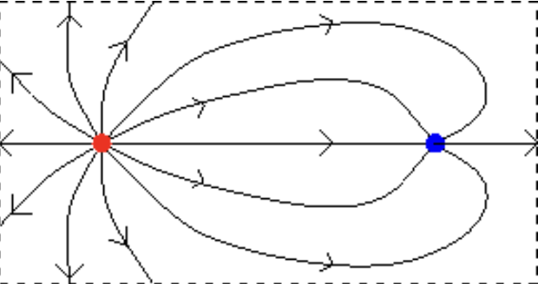
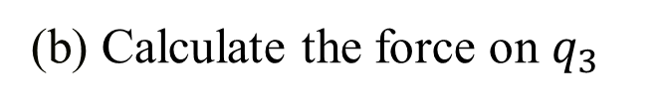
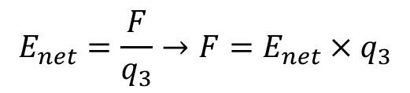
Question 4: ANSWER
(b) Determine the direction of the electric field at this point
The net electric field direction is towards $q_{2}$​ (the negative charge)
(b) Calculate the force on $q_{3}$
$$E_{net}=\frac{F}{q_{3}}→F=E_{net}×q_{3}$$
$$F=1×{10}^{−6}×4.50×{10}^{6}=4.50 N (in the same direction as the electric field)$$
(b) Sketch the electric field lines around the two charges

Slide 22
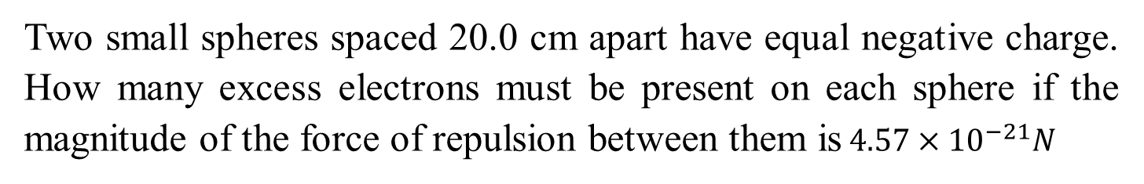
Question 5
Two small spheres spaced 20.0 cm apart have equal negative charge. How many excess electrons must be present on each sphere if the magnitude of the force of repulsion between them is$4.57×{10}^{−21}N$

Slide 23
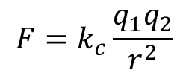
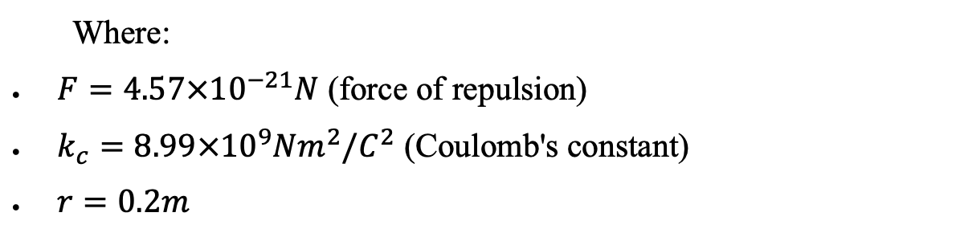
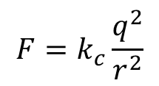
Question 5: ANSWER
Using Coulomb's Law
we can use Coulomb's Law, which relates the force between two charged objects to the magnitude of their charges and the distance between them
$$F=k_{c}\frac{q_{1}q_{2}}{r^{2}}$$
Given that the spheres have equal charge ($q_{1}=q_{2}=q$) and the distance between them is $r=20.0cm=0.200m$, the equation simplifies to:
$$F=k_{c}\frac{q^{2}}{r^{2}}$$
Where:
$F=4.57×{10}^{−21}N$ (force of repulsion)
$k_{c}=8.99×{10}^{9}Nm^{2}/C^{2}$ (Coulomb's constant)
$r=0.2m$

Slide 24
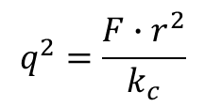
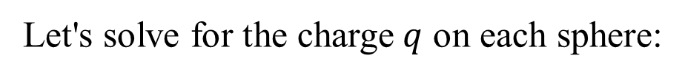


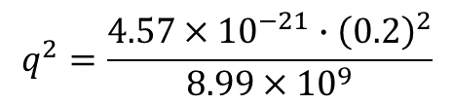
Question 5: ANSWER
Using Coulomb's Law
Let's solve for the charge$q$ on each sphere:
$$q^{2}=\frac{F∙r^{2}}{k_{c}}$$
$$q^{2}=\frac{4.57×{10}^{−21}∙{\left(0.2\right)}^{2}}{8.99×{10}^{9}}$$
$$q=\sqrt{2.033×{10}^{−32}C^{2}}$$
$$q=1.43×{10}^{−16}C$$

Slide 25
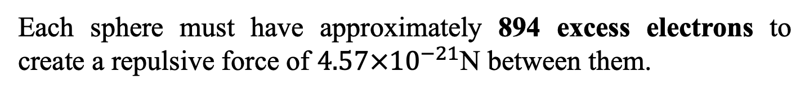
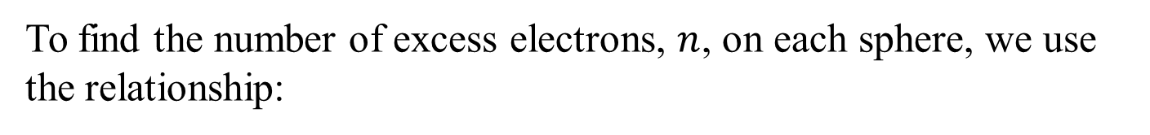

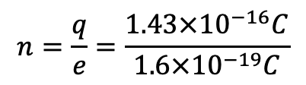

Question 5: ANSWER
The number of excess electrons, $n$, on each sphere
To find the number of excess electrons, $n$, on each sphere, we use the relationship:
$$q=n∙e$$
Where $e$ is the elementary charge $\left(e=1.6×{10}^{−19}C\right)$
$$n=\frac{q}{e}=\frac{1.43×{10}^{−16}C}{1.6×{10}^{−19}C}$$
$$n≈894$$
Each sphere must have approximately 894 excess electrons to create a repulsive force of $4.57×{10}^{−21}$N between them.

Slide 26
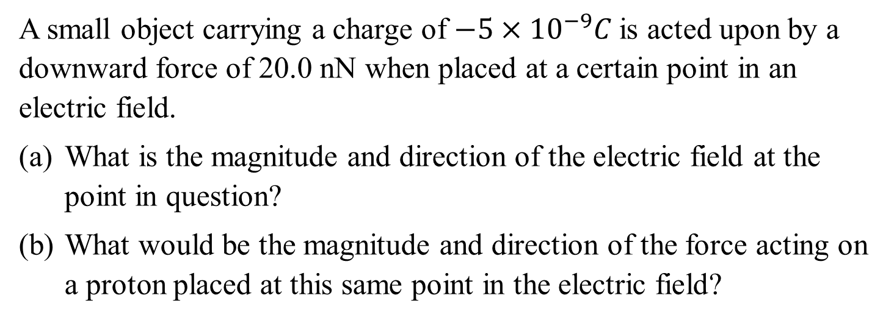
Question 6
A small object carrying a charge of $−5×{10}^{−9}C$is acted upon by a downward force of 20.0 nN when placed at a certain point in an electric field.
What is the magnitude and direction of the electric field at the point in question?
What would be the magnitude and direction of the force acting on a proton placed at this same point in the electric field?

Slide 27
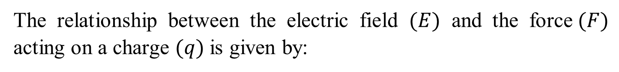
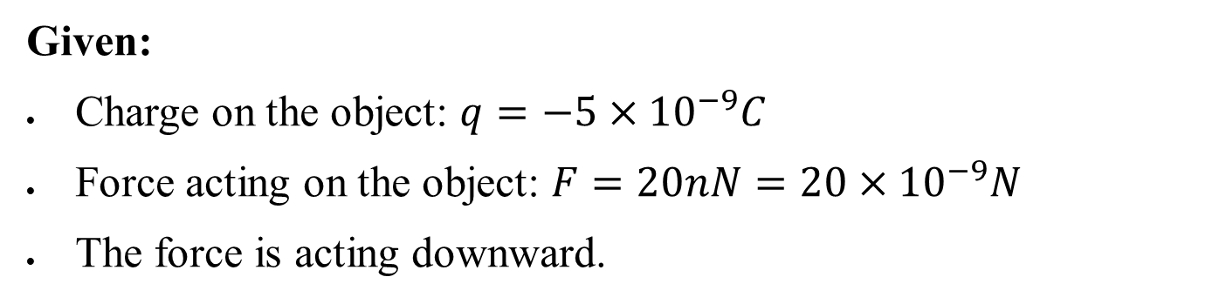
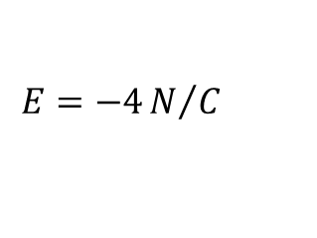
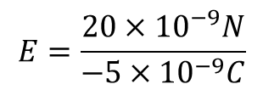

Question 6: ANSWER
Given:
Charge on the object: $q=−5×{10}^{−9}C$
Force acting on the object: $F=20nN=20×{10}^{−9}N$
The force is acting downward.
(a) Magnitude and Direction of the Electric Field
The relationship between the electric field $(E)$ and the force$(F)$ acting on a charge $(q)$is given by:
$$E=\frac{F}{q}$$
$$E=\frac{20×{10}^{−9}N}{−5×{10}^{−9}C}$$
$$E=−4N/C$$
Magnitude: The magnitude of the electric field is $∣E∣=4.0N/C$
Direction: The negative sign indicates that the electric field direction is opposite to the force direction. Since the force is downward and the charge is negative, the electric field must be upward.

Slide 28




Question 6: ANSWER
(b) Magnitude and Direction of the Force Acting on a Proton
The charge of a proton is $q_{p}=+1.6×{10}^{−19}C$
The force on a charge in an electric field is given by:
$$F_{p}=q_{p}∙E$$
$$F_{p}=\left(1.6×{10}^{−19}C\right)∙\left(4N/C\right)$$
$$F_{p}=6.4×{10}^{−19}N$$
Magnitude: The magnitude of the force acting on the proton is $6.4×{10}^{−19}N$.
Direction: Since the proton has a positive charge and the electric field is upward, the force on the proton will also be upward.

Slide 29

Question 7
An electron is released from rest in a uniform electric field. The electron accelerates vertically upward, traveling 4.5 m in the first $3μs$after it is released.
What is the magnitude and direction of the electric field?
Are we justified in ignoring the effects of gravity? Justify your answer quantitatively.

Slide 30



Question 7: ANSWER
Given Data:
Distance traveled by the electron$, d=4.5m$
Time taken, $t=3 μs=3×{10}^{−6}s$
Initial velocity, $u=0 m/s$ (since the electron is released from rest)
Charge of an electron, $e=1.6×{10}^{−19}C$
Mass of an electron, $m=9.11×{10}^{−31} kg$
(a) Finding the Magnitude and Direction of the Electric Field
First, we need to calculate the acceleration $a$ of the electron using the kinematic equation:
$$d=ut+\frac{1}{2}at^{2}$$

Slide 31









Question 7: ANSWER
(a) Finding the Magnitude and Direction of the Electric Field
$$d=ut+\frac{1}{2}at^{2}$$
$$4.5=0+\frac{1}{2}a{\left(3×{10}^{−6}\right)}^{2}$$
Substituting the known values:
$$a=\frac{4.5×2}{9×{10}^{−12}}={10}^{12} m/{s^{2}}$$
Next, we find the electric field $E$ using the relationship between force, electric field, and acceleration:
$$F=ma=eE$$
$$E=\frac{ma}{e}$$
Substituting the values:
$$E=\frac{\left(9.11×{10}^{−31} kg\right)\left({10}^{12} m/{s^{2}} \right)}{1.6×{10}^{−19 }C}$$
$$E=\frac{9.11×{10}^{−19} N/C}{1.6×{10}^{−19 }C}$$
$$E=5.7 N/C$$
The direction of the electric field is downward since the electron, which is negatively charged, accelerates upward (opposite the direction of the electric field).

Slide 32






Question 7: ANSWER
(b) Justification of Ignoring Gravity
To determine if we can ignore the effects of gravity, we compare the gravitational force with the electric force.
$$F_{g}=mg=9.11×{10}^{−31} kg×9.81 m/{s^{2}}$$
$$F_{g}=8.93×{10}^{−30}N$$
The electric force on the electron is:
$$F_{e}=eE=1.6×{10}^{−19}C×5.7 N/C$$
$$F_{e}=9.12×{10}^{−19} N$$
$$\frac{F_{g}}{F_{e}}=\frac{8.93×{10}^{−30}N }{9.12×{10}^{−19} N}=9.79×{10}^{−12}$$
Comparing the two forces:
The electric force is about ${10}^{11}$times greater than the gravitational force,
making the effect of gravity negligible.
Therefore, we are justified in ignoring the effects of gravity in this situation.

Slide 33


Question 8
Two-point charges$q_{1} and q_{2}$ and are held 4.00 cm apart. An electron released at a point that is equidistant from both charges (see figure below) undergoes an initial acceleration of ${8.25×10}^{18} m/s^{2}$directly upward as shown in the figure, parallel to the line connecting $q_{1} and q_{2}$ . Find the magnitude and sign$q_{1} and q_{2}$.

Slide 34

Question 8: ANSWER
Given:
Two-point charges $q_{1} and q_{2}$ are held $4.00 cm$ apart.
An electron is released equidistant from both charges.
The initial acceleration of the electron is ${8.25×10}^{18} m/s^{2}$, and it is directed upward.
We need to find the magnitude and sign of $q_{1} and q_{2}$.
The charges $q_{1} and q_{2}$ ​ are separated by a distance of $d=4.00cm=0.04m$.
The electron is placed on the perpendicular bisector as show, and from the geometry the distance from the electron to each charge is $d=\sqrt{{0.02}^{2}+{0.03}^{2}}=0.0361m$.

Slide 35



Question 8: ANSWER
Calculate the charges $q_{1} and q_{2}$
The electric field due to a single point charge is given by:
$$E=k_{c}\frac{\left|q\right|}{r^{2}}$$
where:
$k_{c}​=8.99×{10}^{9}N⋅m^{2}/C^{2}$ is Coulomb's constant,
$q$ is the magnitude of the charge,
$r$ is the distance from the charge to the point where the electric field is being calculated.
Since the electron is equidistant from both charges, the net electric field $E_{net}$​ will be the sum of the electric fields due to $q_{1} and q_{2}$​ as vectors. In order the resultant force to be upwards the charge $q_{2}$ must be negative while the charge $q_{1}$must be positive. Furthermore their magnitude must be equal so that there is no horizontal component in the total force (acceleration is initially straight up).

Slide 36




Question 8: ANSWER
Calculate the charges $q_{1} and q_{2}$
$E_{net}=2×k_{c}\frac{\left|q\right|}{r^{2}}$ sin($θ$)
The net electric field at the midpoint will be:
Where sin($θ$)=2/$\sqrt{13}$ and $r^{2}={0.02}^{2}+{0.03}^{2}=0.013$
Relate the Electric Field to the Force on the Electron
The force on the electron is given by:
$$F=e×E_{net}$$
where $e=1.6×{10}^{−19}C$ is the charge of the electron.
Using Newton's second law:
$$F=m_{e}×a$$
where:
$m_{e}​=9.11×{10}^{−31}kg$ is the mass of the electron,
$a={8.25×10}^{18} m/s^{2}$, is the acceleration of the electron.

Slide 37








Question 8: ANSWER
Calculate the charges $q_{1} and q_{2}$
Equating the force expressions:
$$e×E_{net}=m_{e}×a$$
Substituting $E_{net}$​:
$$e×2×k_{c}\frac{\left|q\right|}{r^{2}}\text{sin}\text{(}θ\text{)}=m_{e}×a$$
$$\left|q\right|=\frac{m_{e}×a×r^{2}}{e×2×k_{c}×\text{sin}\text{(}θ\text{)}}$$
$$\left|q\right|=\frac{\left(9.11×{10}^{−31}kg\right)×\left({8.25×10}^{18} m/{s^{2}}\right)×(0.0013)}{\left(1.6×{10}^{−19}C\right)×2×\left(8.99×{10}^{9}N⋅{m^{2}}/{C^{2}}\right)∗(\text{2/}\sqrt{13})}$$
$$\left|q\right|=6.11×{10}^{−6}C$$
So, the magnitude of $q_{1} and q_{2}$​ is
$$6.11×{10}^{−6}C$$

Slide 38



Question 8: ANSWER
Determine the Sign of the Charges
Since the electron is accelerated upward, and we assumed that $q_{1} and q_{2}$​ have opposite signs, the upward force must be due to a repulsive force from a negative charge $q_{1}$ and an attractive force from a positive charge $q_{2}$​. Thus:
$$q_{1}=+6.96×{10}^{−8}C$$
$$q_{2}=−6.96×{10}^{−8}C$$

Slide 39
Q&A? Office hours:

Slide 40

Question 9-Extension
An electron moving to the right at $7.5 105 m/s$enters a uniform electric field parallel to its direction of motion. If the electron is to be brought to rest in the space of 4.0 cm;
what direction is required for the electric field and
what is the strength of the field?

Slide 41






Question 9: ANSWERS
(a) what direction is required for the electric field
The electron will experience a force in the opposite direction to the electric field. Since the electron is to be brought to rest, the electric field must be in the same direction as the initial velocity of the electron.
(b) the strength of the field
$$a=\frac{q.E }{m}$$
$v^{2}=v_{0}^{ 2}+2a∆x$ $=v_{0}^{ 2}+2\frac{q.E }{m}∆x$
$$F=q.E=m.a→$$
$$E=− \frac{\left(9.109 ×{10}^{−31}kg\right){\left(7.5 ×{10}^{5} m.s^{−1}\right)}^{2}}{2×\left(−1.602×{10}^{−19} C\right)×\left(0.04 m\right)}$$
$E= \frac{m\left(v^{2}−v_{0}^{ 2}\right)}{2q∆x }$ $=−\frac{mv_{0}^{ 2}}{2q∆x }$
$$E=40 N/C$$

Slide 42


Question 10-Extension
Determine the direction and magnitude of the electric field at the point P shown in the figure. The two charges are separated by a distance, 2a. Point P is on the perpendicular bisector of the line joining the charges, a distance, $x,$ from the midpoint between them. Express your answer in terms of Q, $x$, a, and k.

Slide 43








Question 10: ANSWER
From the diagram, note that the $x$components of the two fields will cancel each other at the point P. Thus, the net electric field will be in the negative y-direction, and will be twice the y-component of either electric field vector.
$$E_{net(x)}=−E\sin{θ+E\sin{θ=0}}$$
$$E_{net(y)}=−E\sin{θ−E\sin{θ}}=−2E\sin{θ}$$
$$E=k\frac{q}{r^{2}}$$
$$sinθ=\frac{a}{\sqrt{\left(a^{2}+x^{2}\right)}}$$
$$E_{net}=−2E\sin{θ}=−2\frac{kQ}{x^{2}+a^{2}}\sin{θ}$$
$$E=\left(\frac{−2kQ}{x^{2}+a^{2}}\right)\frac{a}{{\left(x^{2}+a^{2}\right)}^{1/2}}=\frac{−2kQa}{{\left(x^{2}+a^{2}\right)}^{3/2}}$$
in the negative y-direction.

Slide 44
Question 11-Extension
Two charges, -Q₀ and -4Q₀, are a distance, 𝑙, apart. These two charges are free to move, but do not because there is a third charge nearby. What must be the magnitude of the third charge and its placement in order for the first two to be in equilibrium?

Slide 45













Question 11: ANSWER
The negative charges will repel each other, and so the third charge must put an opposite force on each of the original charges.
Consideration of the various possible configurations leads to the conclusion that the third charge must be positive and must be between the other two charges.
$−$Q₀
Q
$−4$Q₀
For each negative charge, equate the magnitudes of the two forces on the charge. Also, note that $0<x<1.$
$$1$$
$$3$$
$$2$$
$$x$$
$$l−x$$
$$l$$
$$F_{12}=k\frac{4{Q_{0}}^{2}}{l^{2}}$$
$$F_{13}=k\frac{QQ_{0}}{x^{2}}$$
$$F_{23}=k\frac{4{QQ}_{0}}{{\left(l−x\right)}^{2}}$$
$$F_{21}=k\frac{4{Q_{0}}^{2}}{l^{2}}$$

Slide 46












Question 11: ANSWER
For charge 1
$$for the system to be balanced the net force must be zero (0)$$
$$k\frac{QQ_{0}}{x^{2}}=k\frac{4{Q_{0}}^{2}}{l^{2}}→$$
$$Q{=\frac{4x^{2}}{l^{2}}Q}_{0}$$
…… (1)
$$F_{12}=F_{13}→$$
For charge 2
$$k\frac{4{QQ}_{0}}{{\left(l−x\right)}^{2}}=k\frac{4{Q_{0}}^{2}}{l^{2}}→$$
$$Q=\frac{{\left(l−x\right)}^{2}}{l^{2}}Q_{0}$$
$$F_{23}={ F}_{21}→$$
…… (2)
Solving (1) and (2)
$${\frac{4x^{2}}{l^{2}}Q}_{0}=\frac{{\left(l−x\right)}^{2}}{l^{2}}Q_{0}→$$
$4x^{2}={\left(l−x\right)}^{2} →x$=$\frac{l}{3}$
$$Q{=\frac{4x^{2}}{l^{2}}Q}_{0} {=\frac{4{\left(\frac{l}{3}\right)}^{2}}{l^{2}}Q}_{0}→$$
Substitute $x= \frac{l}{3}$ into (1)
$$Q={4Q0}/9$$
Thus, the charge should be of magnitude ${4Q0}/9$ at a distance, $l/3$, from $−Q0$ towards $−4Q0$

